Slide 1

Text Clustering
By: Seinfeldian Abdelghani, Sara Abdelghafar, Omar Sorour, and Zeyad Elsayed

Slide 2
INTRODUCTION
Different Schools of Philosophy.
Ideas and thoughts of the authors of a school reflect in their writings.
Labeling the documents and grouping them to their school of thought is a bit problematic.​
Using clustering techniques to automatically label documents of five different books.

Slide 3

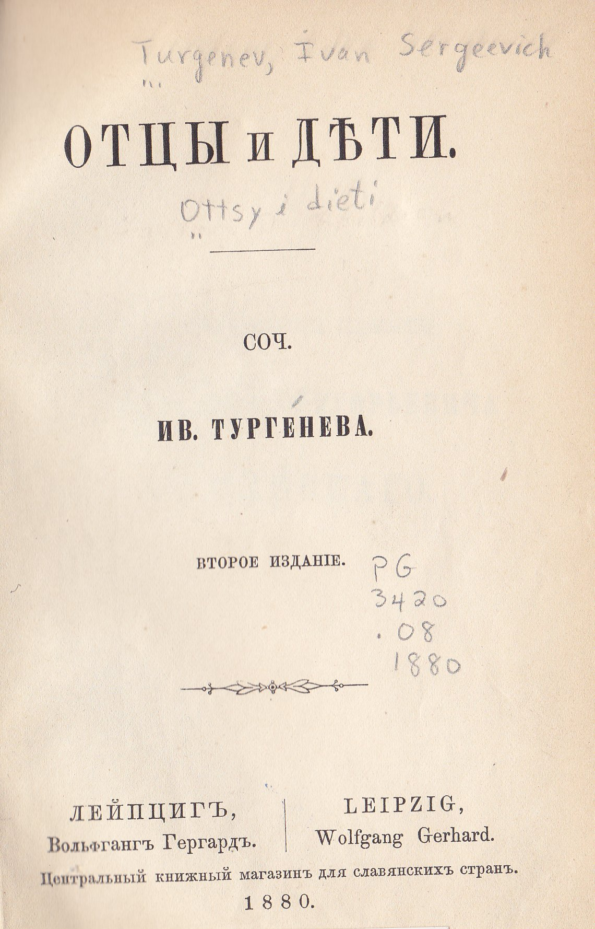
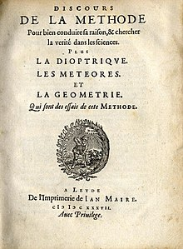
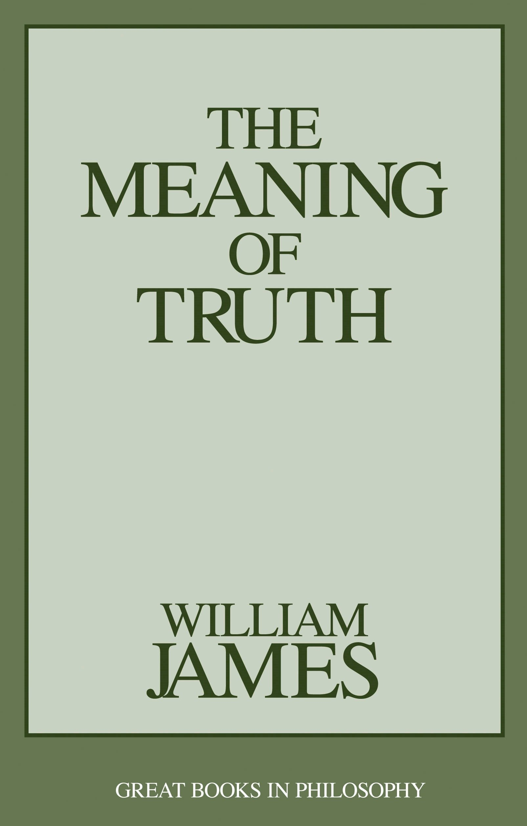
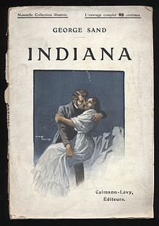
Schools of philosophy
Existentialism
Nihilism
Rationalism
Pragmatism
Idealism
Notes from Underground
Fathers and Sons
A Discourse on Method
The Meaning of Truth
Indiana
Fyodor Dostoevskey
Ivan Turgenev
René Descartes
William James
George Sand

Slide 4
Framework
Text Clustering of 5 books belonging to 5 different schools of philosophy.
Different Feature Extraction Techniques.
Different Feature Reduction Techniques.
Different Clustering Algorithms.
Best Model with Highest Performance.

Slide 5
Data preparation
Data Cleaning
Stemming and Lemmatization
Data Partitioning
Tokenization
Labeling

Slide 6
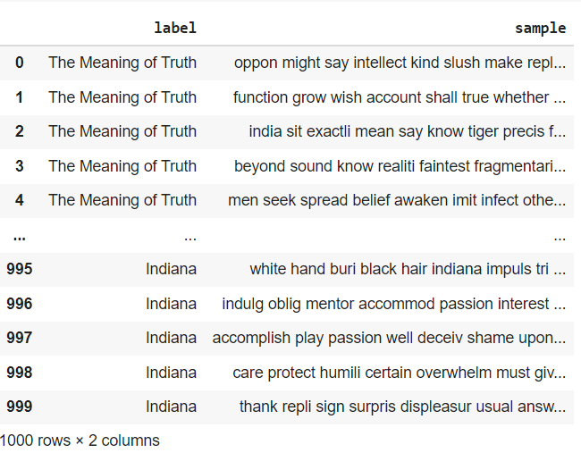
Output of Data preparation

Slide 7
Feature extraction
Bag of Words
TF-IDF
N-gram
Latent Dirichlet Allocation
Doc2Vec

Slide 8
Feature reduction
Singular Value Decomposition (SVD)
t-distributed stochastic neighbor embedding (t-SNE)
Without any Feature Reduction

Slide 9
Model training
Using Scikit Learn Packages to train 3 Models:
K-means Clustering
Agglomerative Clustering
Expectation Maximization(EM)
Combining each of the feature extraction methods with each of the feature reduction, we train each of the models with 9 different Combinations, So in total we trained 45 different models.

Slide 10
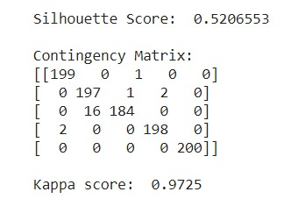
Model evaluation
We Calculate Contingency matrix.
Kappa
Silhouette
Evaluation of EM model with TF-IDF & t-sne

Slide 11
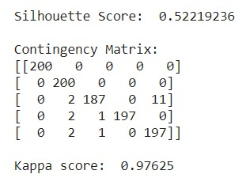
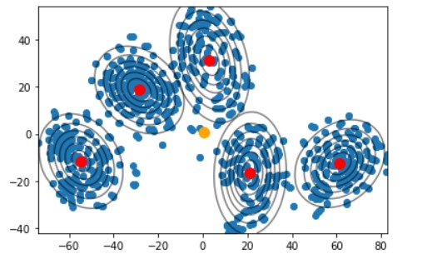
Champion model
Among all the generated models, combination of K-means model with TF-IDF feature extraction and t-sne for feature reduction, was of highest performance.

Slide 12
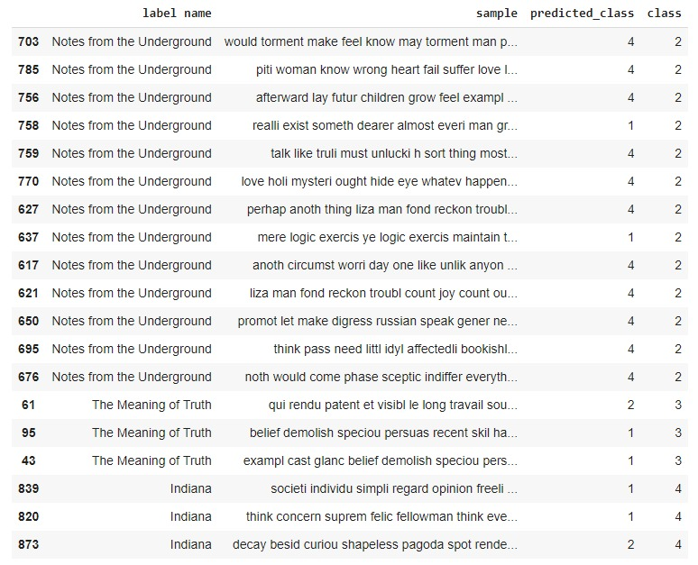
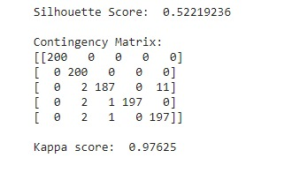
Error analysis – Champion model

Slide 13
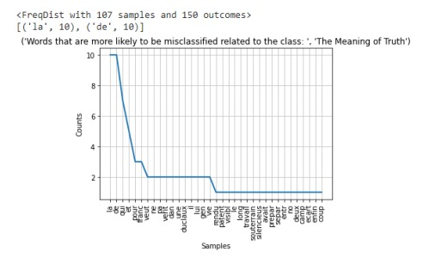
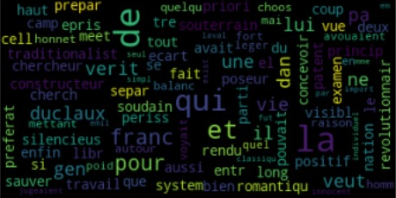
Error Analysis – The meaning of truth

Slide 14
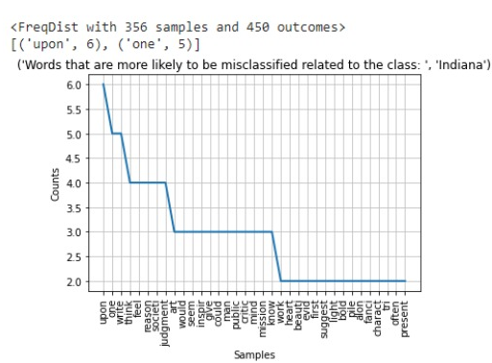
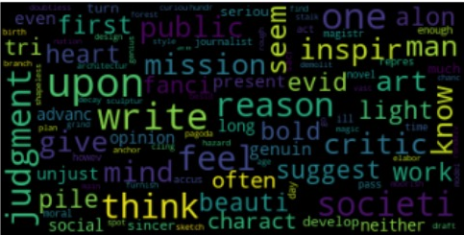
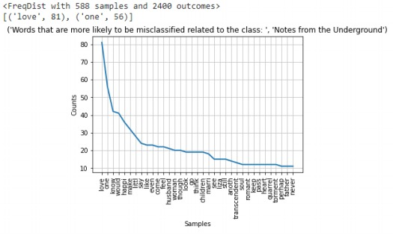
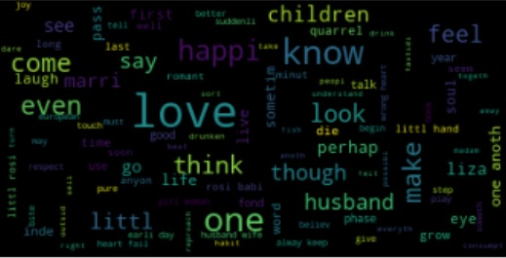

Slide 15
Future work
Work on the hyper-parameter tuning to enhance the silhouette and the kappa measure
Generalize the clustering model by adding more books for the same philosophical school.
Trying the deep neural networks algorithms in clustering.

